Slide 1
C++ Basics IV

Slide 2
Homework

Slide 3
Readability

Slide 4
sort/fill

Slide 5
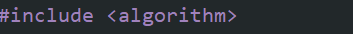
Sorting
There are many different sorting algorithms out there, and we will create some in the future!
For now you should take note of a very useful built-in sort method.
We’ll need to include <algorithm> for both sort and fill.

Slide 6
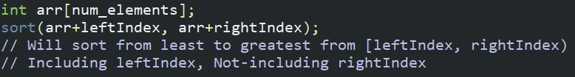
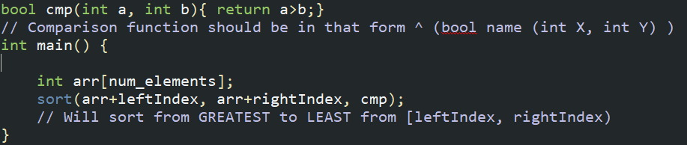
Sorting continued
The sort function is implemented like this:
We can also create our own comparison function:

Slide 7
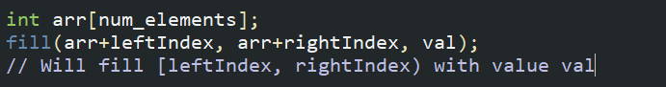
Fill
Fill is a straightforward function that will fill an array with a certain value. It is implemented like this:

Slide 8
vectors

Slide 9
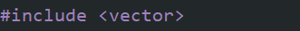
What are vectors?
Vectors are essentially dynamic arrays.
They can contain many elements, but there is no restriction on size.
You can add, access, and delete elements to a vector anytime.
You must include vectors using the #include keyword!

Slide 10
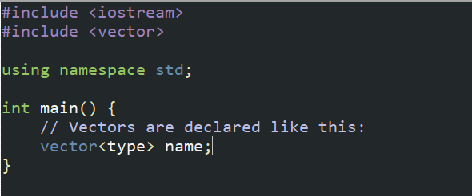
Declaration
Type can be any type!
It can be an int, a double, a string, or even another vector!

Slide 11
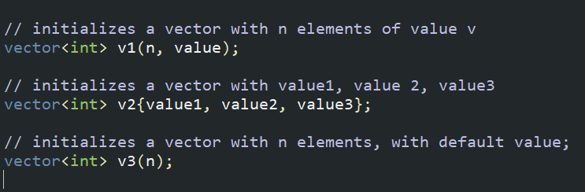
Declaration
You can also declare vectors like:

Slide 12
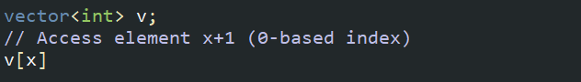
Vector access
Vectors are accessed in the same way that arrays are:

Slide 13

Insert/delete
Insertion and deletion in vectors stem from functions in the <vector> library. The most common ones are:

Slide 14
Foreach loop

Slide 15
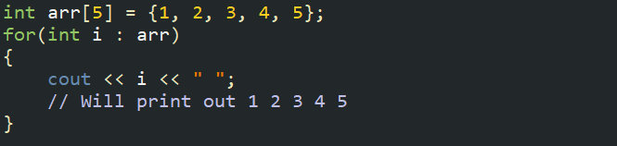
What is a foreach loop?
A foreach loop is a type of for loop that cycles through each element in a container (arrays, vectors, etc.).

Slide 16
Exercise 1
Create an array with numbers 1-100.
Create 2 vectors that will store the even and odd numbers respectively.
Print each array at the end.

Slide 17
Exercise 2
Print the numbers from 1 – 100 in zigzag order (1 100 2 99 3 98…)
Requirements:
You must use a vector as a container
You must use a foreach loop to print

Slide 18
Homework 1
Bubble sort is a famous type of sorting algorithm that works via the following procedure:
Loop through each element of the array.
If the current element is less than the next element, swap them.
Repeat until the array is sorted.
Code it!

Slide 19
Homework 2
Binary Search is an algorithm on a sorted array that finds us an element in the array quickly.
How it works is we have two variables lo (0) and hi (size of container), representing our search range.
For every iteration:
If the middle value of the range is lower than the element, it must be in the upper half. Otherwise, if it is greater than the element, it must be in the lower half. If it is the element, return true. If you can’t find the element (lo>hi), return false.
Using a sorted array with numbers from 1-10000, code it! Test it for all numbers!

